Slide 1
Tessa Penich Vibrant Communities Calgary Member of the Alberta Living Wage Network
Living Wage:
The Bigger Picture

Slide 2
By the time we’re done, you’ll know all about…
what a living wage is
how a living wage helps attract and keep employees
how a living wage affects communities

Slide 3
A Living Wage is the amount of income an individual or family needs to:
Meet their basic needs
Maintain a safe, decent standard of living
Participate in their community
What is a living wage?
Notes:
The living wage is the hourly wage a worker needs to earn (if working full time) to cover their basic expenses and participate in the community
It is based on the actual costs of living in a specific community
Living wages are rooted in the belief that individuals and families should not just survive, but be able to live in dignity, and participate in their community

Slide 4
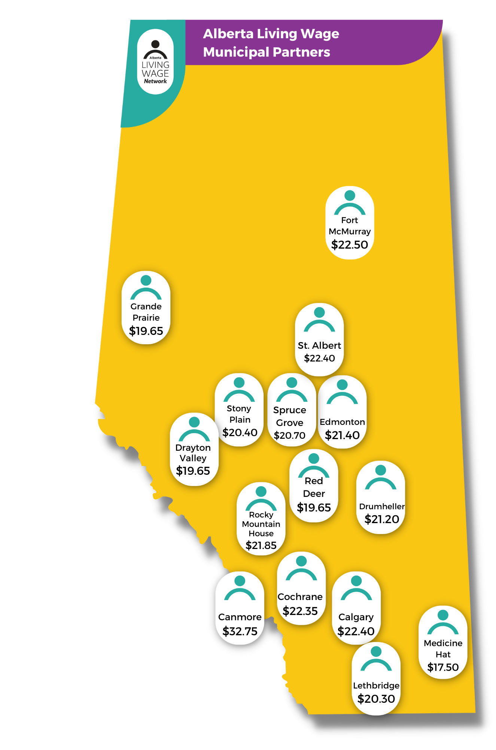
Minimum Wage
Living Wage
$15/$13 across Alberta
Mandatory
Can work full time and still live in poverty
Community specific
Voluntary
Able to make ends meet if working full-time
Notes:
The minimum wage is the same across the province, even though it costs more to live in some places than others.
On the other hand, each community has its own living wage rate – it’s calculated using community-specific data, reflecting the cost of living in each specific community.
Minimum Wage: It’s not tied to inflation, so worker’s buying power decreases every year the minimum wage doesn’t keep pace with inflation.
Living Wage: is updated every year. As often as possible we use freshly gathered data, or we use the Consumer Price Index to adjust for inflation.
The minimum wage is mandatory– it’s legislated by the government.
The living wage is an optional commitment of employers to go beyond the minimum standard and pay enough for employees to meet a reasonable standard of living.
For years the minimum wage has been too low to lift even someone working full-time above the poverty line.
The living wage is based on the principle that if you work full- time for a full year, you should earn enough to make ends meet and participate in your community.
We ask people to consider what it costs to make ends meet, and whether someone working full-time should be able to do that on the wage they are paid.

Slide 5
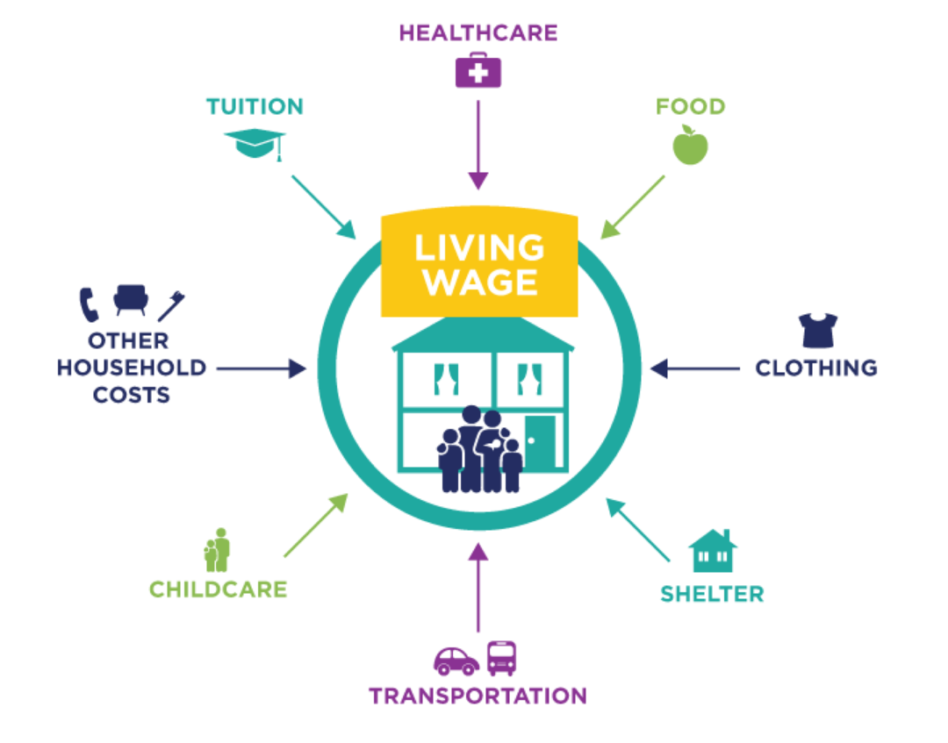
How is a living wage calculated?
Notes:
Costs coming out, savings going in
Realistic (breakdown of costs)
Food
Clothing and Footwear
Housing (rent, utilities, and insurance)
Transportation
Childcare (for the categories it applies too)
Healthcare
Other household costs: phone, internet, household goods, health and fitness, personal care and hygiene, leisure and entertainment, holidays, any health care costs outside of benefits (medication, etc), house and yard maintenance, and on and on)
Contingency Fund: 2 weeks pay. Sickness, bereavement, family emergency, moving, work shutdowns, etc)
Tuition: One distant ed. course per semester ($1700 / term)
Local
Numbers for a living wage is sourced from on the ground research or community specific data –these are Drumheller numbers.
Call Local Day care rates, Rental Rates that came from Century 21, Monthly Averages for Gas prices from a local gas station, Dieticians walked through our grocery stores and looked at our prices (National Nutritious Food Basket Survey)
Net Income (includes applicable government subsidies and tax breaks)
Canada Child Benefit, Alberta Affordability Grant (soon), Childcare Subsidies, etc.
This is an accurate picture of predictable money coming in and out for households in our community.
Also has the benefit of being a tool to see what difference government subsidy and support programs make for low wage earners.

Slide 6
Who Benefits?
Individuals:
Gives individuals more freedom to nurture their personal, professional, and community relationships
Contributes to better mental and physical health
Notes:
GIVES INDIVIDUALS MORE FREEDOM TO NURTURE THEIR PERSONAL, PROFESSIONAL, AND COMMUNITY RELATIONSHIPS
Increases ability to spend more time and participate in activities with loved ones from not having to balance multiple jobs or extra shifts.
Gives freedom to support the community by donating to various causes.
Enhances relationship with employer and fosters loyalty as it signals the value and respect towards employees.
CONTRIBUTES TO BETTER MENTAL AND PHYSICAL HEALTH
Reduces stress by not having to worry about access to basic necessities.
Improves wellbeing by having the means to afford participation in social activities and recreation.
Increases access to healthier food options.
When we interviewed people with lived and living experience, they told us they would’ve spent this money on things like healthy food, buying a gym membership, not cutting their prescription medications in half, etc. This also benefits society because of savings to healthcare costs!

Slide 7
Who Benefits?
The High Cost of Low Wages, Harvard Business Review
Employers:
Benefits Available to Employees
 | Costco | Wal-Mart’s Sam’s Club
Wages | $17/hour | $10.11/hour (average)
Health Benefits | 82% are covered with 8% premium | Less than 50% are covered with 33% premium
Retirement Plan | 91% are covered with $1,330 annual contribution per employee | 64% are covered with $747 annual contribution per employee
Cost to the Company
 | Costco | Wal-Mart’s Sam’s Club
Turnover | 17% overall, 6% after one year’s employment | 44% a year (based on Wal-Mart numbers)
Turnover Cost (estimates) | $244 million | $612 million
Notes:
A study in the Harvard Business Review compared Costco with Walmart’s Sam’s Club – similar businesses, but big disparity in pay: Costco paid $17/hour while Sam’s Club paid $10.11
Costco had a 17% turnover rate compared to Sam’s Club’s 44%. In skilled and semi-skilled positions, the cost of replacing an employee is 1.5 to 2.5 times the worker’s salary. This translates to a cost savings of $368M for Costco compared to Sam’s Club across the US
Every employer and every business is different and is operating in their own unique circumstances, so paying a living wage will affect each employer differently, but this is just one specific example that shows how low wages can translate to higher costs

Slide 8
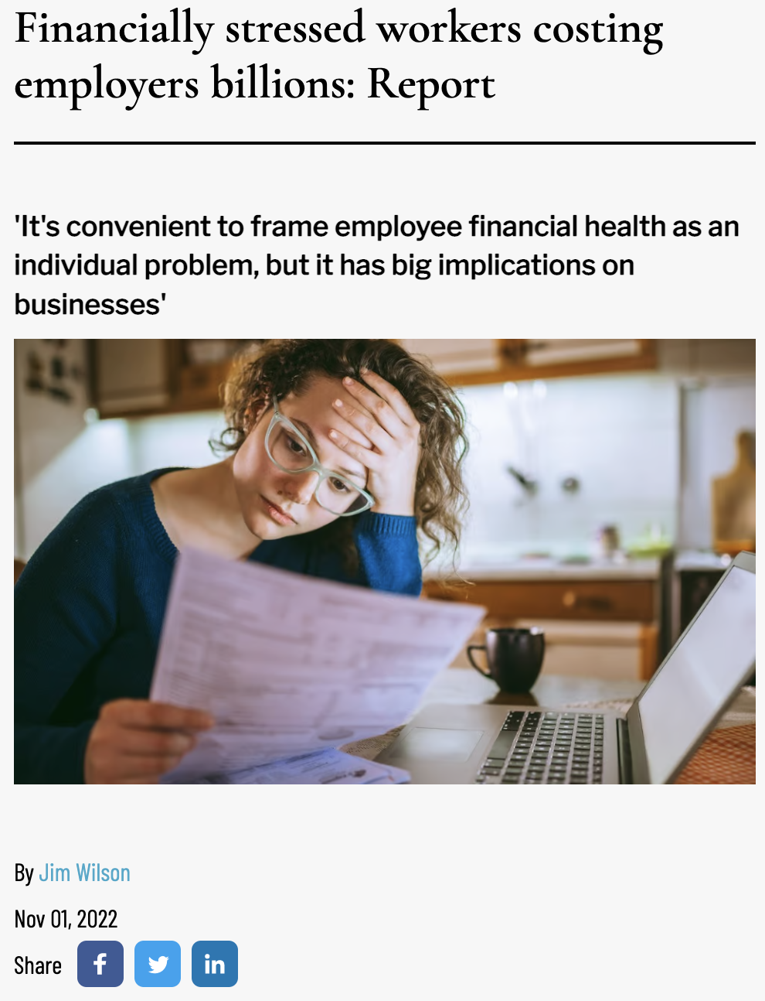
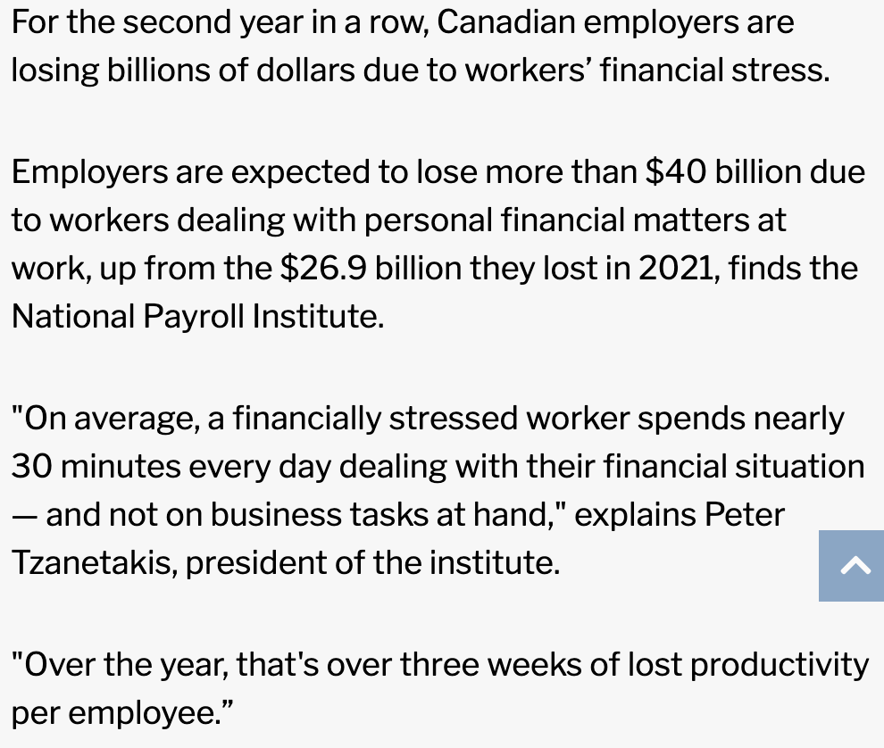
Notes:
Another study by the National Payroll institute estimated that Canadian employers would lose $40 billion over the year from having financially stressed workers. Workers who get paid a living wage will have less financial stress and will be be more productive.

Slide 9
Who Benefits?
Employers:
97% of Living Wage Employers* reported at least one benefit
*According to B.C. Living Wage surveys
Notes:
The Network just launched its employer program in November 2021, and we haven’t surveyed our living wage employer yet (hopefully we will soon), but BC has been certifying employers since 2010 and have over 400 living wage employers – when they surveyed their employers, 97% said that they benefitted somehow, most seeing good publicity and increased staff morale, and many reported that it helped with recruiting staff and lowering staff turnover
The UK are the world leaders of the living wage movement, and they’ve been at it for more than 20 years. Their survey of more than 800 accredited real Living Wage businesses found that 93% reported they benefitted:
Living Wage accreditation has:
86% said it enhanced the organisation’s reputation as an employer
64% said it differentiated the organisation from others in the same industry
58% said it improved relations between staff and managers
57% said it increased commitment and motivation of Living Wage employees
53% said it improved recruitment of employees into jobs covered by the Living Wage
70 per cent of employers stated that they had ‘absorbed the cost of the Living Wage without making major changes’.
over 50% of surveyed employers reported that the Living Wage had improved both recruitment and retention while a nearly half (45 per cent) reported that accreditation had ‘improved the quality of applicants for Living Wage jobs’
https://www.livingwage.org.uk/news/real-living-wage-good-business-good-society

Slide 10
What we’ve heard from our certified employers
“For Nightwind Treatment Centre, compensating a living wage leads to improved productivity, increased employee loyalty, and decreased costs associated with absent staff, training, and recruitment.
Michelle J. Thoret, Executive Director, Nightwind Treatment Centre

Slide 11
Who Benefits?
Community:
Stimulates the local economy
Helps build sustainable and vibrant communities
Alleviates the financial cost of poverty
Helps advance societal equity and inclusivity
Notes:
Stimulates the Local Economy
Increases the purchasing power of low-income community members, which in turn generates local spending as they tend to spend their wage on immediate needs
A study by Goldman Sachs found that when low-income earners get a raise, they spend it in their community, which boosts the local economy. But when high-income earners get a raise, only between 3-5 cents of each dollar goes into the economy. 95-97% of the raise is gone: invested outside of Canada, spent on vacation, etc.
Helps build sustainable and Vibrant Communities
Workplaces that offer a living wage attract and retain employees, who in return stay in the community for a longer term and this is especially pronounced in regional communities
A JPMorgan Chase & Co. study found that younger and lower income consumers make up the bulk of spending for small businesses
Alleviates the financial cost of Poverty
Poverty costs Alberta approximately $7.1 to $9.5 billion per year due to the demand it puts on the health care and justice system, and foregone tax revenue.

Slide 12
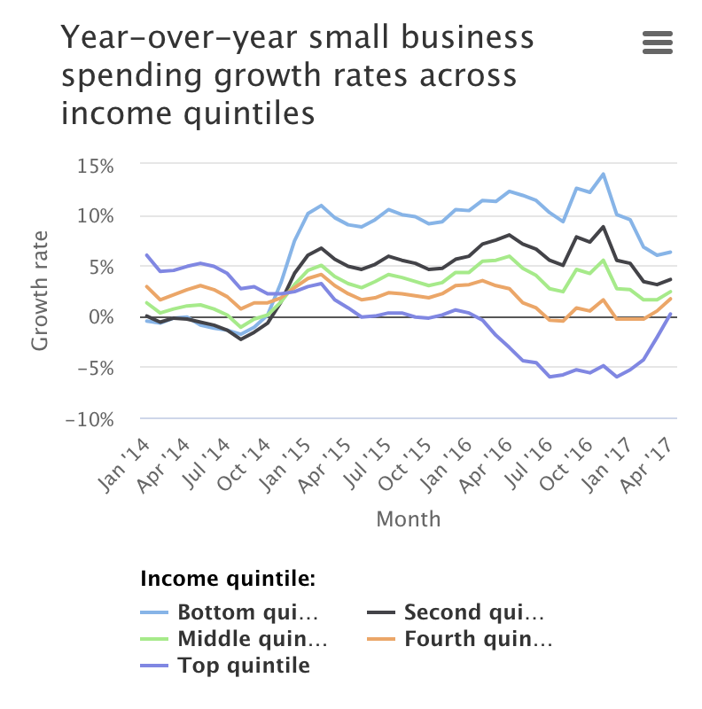
Notes:
Here’s a chart from a JPMorgan Chase study – the light blue represents growth in small business spending by the lowest-income individuals, who make up the bulk of the spending on small businesses. The dark blue line represents the highest income individuals, who account for much less of the growth in spending on small businesses

Slide 13
What we’ve heard from our certified employers
“Paying the living wage means that we are able to contribute to our community exponentially – our employees' salaries feed right back into the Valley's economy.”
Dr. Sarah Newstead, Executive Director, Atlas Coal Mine
Notes:
-Atlas Coal Mine is working on finalizing their certification, however they currently pay their employees a living wage

Slide 14
Notes:
Let’s give an example of how a living wage makes a difference in a community. Economists love to make oversimplified models of the world, and our Economist created this world to illustrate the power of a living wage. In this community, there are 3 businesses: one grocery store, one gym, and one theatre.

Slide 15
Notes:
In this community, the employees in each business don’t make a living wage. They can’t buy the groceries they want (they get mostly ramen and KD), they can’t afford to go to the gym, and they can’t afford to go to the theatre. But they all want to.
And each businesses isn’t making much revenue

Slide 16
Notes:
Now the grocery store hears about the benefits of a living wage. They want to decrease turnover and increase productivity, so they start paying a living wage to see what happens.
Now their employees are happy (see the happy face and hearts), and they can now afford to buy the food they want, they got a gym membership, and they can watch plays at the local theatre
The teal dollar signs represent new revenue that each business now gets from the employees of the grocery store who now make a living wage
The grocery store also attracts the best employees, as workers from the gym and theatre jump at any opportunity to work at the grocery store

Slide 17
Notes:
Now that t the grocery store employees bought a gym membership, the gym has more revenue. The owner decides that they can now afford to pay a living wage.
Now their employees are happier (smiley & hearts), and you’ll see there are 2 dollar signs above each business. That’s because the employees of the gym can now afford to buy the food they want, get a gym membership, and watch plays at the theatre. The navy blue dollars represent the new revenue from them
And now they attract the best employees along with the grocery store, and the theatre is left with the leftovers
Notice how the theatre is better off, even though they don’t pay a living wage. They also have 2 dollar signs. This is because when any employer in the community pays a living wage, spending in the local economy increases and all businesses benefit, even the ones who don’t pay a living wage (the downside for them is they are less competitive when it comes to recruiting and retaining staff)

Slide 18
Notes:
The theatre is now making 2 dollar signs of revenue, so they decide to put some of it into paying a living wage
This boosts their revenue and the revenue in all the other businesses to 3 dollar signs! Everyone benefits from the theatre employees now being able to buy the groceries they want, join the gym, and watch plays (note that this example has been validated in real life from interviews we did with people making below a living wage – we interviewed someone who works in the theatre industry, and they said they wish they could afford to watch plays – if they made a living wage, they would watch plays. So even though they worked in the theatre industry and loved plays, they couldn’t afford to see them!)
Which community would you rather live in? This one, with all the smiley faces and hearts and dollar signs? Or the one with 3 sad faces and no dollar signs? Which one would you rather plant roots in, raise a family in…
And this is the bigger picture of a living wage. It’s the long game of employee retention. If the local economy sucks and they can’t make ends meet, people are more likely to move to a different part of the province/country where they can make ends meet. But if people are making a living wage and there are more people participating in the community and supporting local businesses, it’s a better place to work and plant roots. And that’s the ultimate employee retention. And when people can afford to participate in the community and have the time to do it (instead of working multiple jobs to make ends meet), it makes for a more vibrant community that people want to live in, and more revenue for local businesse.

Slide 19
Part of a Bigger Picture
A living wage means happier people, thriving businesses, and a vibrant community!
Notes:
The ripple effects of a living wage are far reaching and profound. When employers pay a living wage, they get more productive employees who want to stick around. Workers have less stress, can buy healthier food, and have more time to spend with loved ones. And when people can afford to participate in their community, they're more likely to plant roots, and local businesses benefit from the increased spending. A living wage means happier people, thriving businesses, and a vibrant community!
You're changing the cities and towns you operate in into places that people want to live. That's the long game of retention. And better for small businesses - people with great ideas will be comfortable setting up shop here.

Slide 20
Steps to Certification
Apply online with help from Ryan, Coordinator of the Network
Sign license agreement upon approval
Notify your employees (and everyone else!)
Your annual membership fee is waived for the first year
Becoming a Living Wage Employer
Notes:
Online application form
Includes Living Wage Implementation Plan if you’re not already paying a Living Wage
Ryan Lacanilao is the Network’s Director. He works with prospective employers to approve or help plan their implementation process. He’s happy to walk through numerous scenarios to see what being a Living Wage Employer might look like for your business.
Not meant to be an onerous process, but for some businesses it takes some creative solutions to make it happen.
Contact if you’re just curious
Review, approval, and sign license agreement
Can be terminated by either party at any time
Notify your employees (and everyone else!)
Worth celebrating!
We’ll be looking for ways to highlight and promote Living Wage Employers in the coming year.
Annual fee is waived for the first year of membership Sliding scale according to size of organization as well as public/not-for-profit vs private
Profit or not-for-profit and then based on number of employees ($50-$400 not for profit; $100 to $1000 (500+ employees) private)
Application online, or reach out to the Network and they can help you walk through the process.
Commitment to pay employees

Slide 21
Notes:
You’ll be joining nearly 100 other employers across the province. Alberta Living Wage employers range throughout the province, and across all sectors, from: construction, consulting, and cleaning; to distribution, home care, software, solar and retail; not-for-profits and service providers like Food Banks, United Ways, senior and youth foundations.

Slide 22
Thank you! For more information: IG: @livingwageab livingwagealberta.ca Tessa Penich: tessa@vibrantcalgary.com Ryan Lacanilao: coordinator@livingwagealberta.ca

